Slide 1
Stages, Tasks, Workflow and Tools in the preparation of Patent Landscape Reports
Bangkok
29 January 2018
Irene Kitsara
IP Information Officer, Access to Information and Knowledge Division

Slide 2
Profile of Patent Landscape Reports (PLR) users/clients
Industry: typical PLR providers and users. Landscaping: standard procedure included in decision making mechanism (patent portfolio management, R&D investment and prioritization, technology transfer etc).
Public sector:
Providers: National Patent Offices/research institutes preparing reports in areas of general interest/specific need or providing landscaping services to the public
Users: awareness raising phase – more and more public institutions seeking ways to facilitate their policy discussions and similar to the private sector decisions

Slide 3
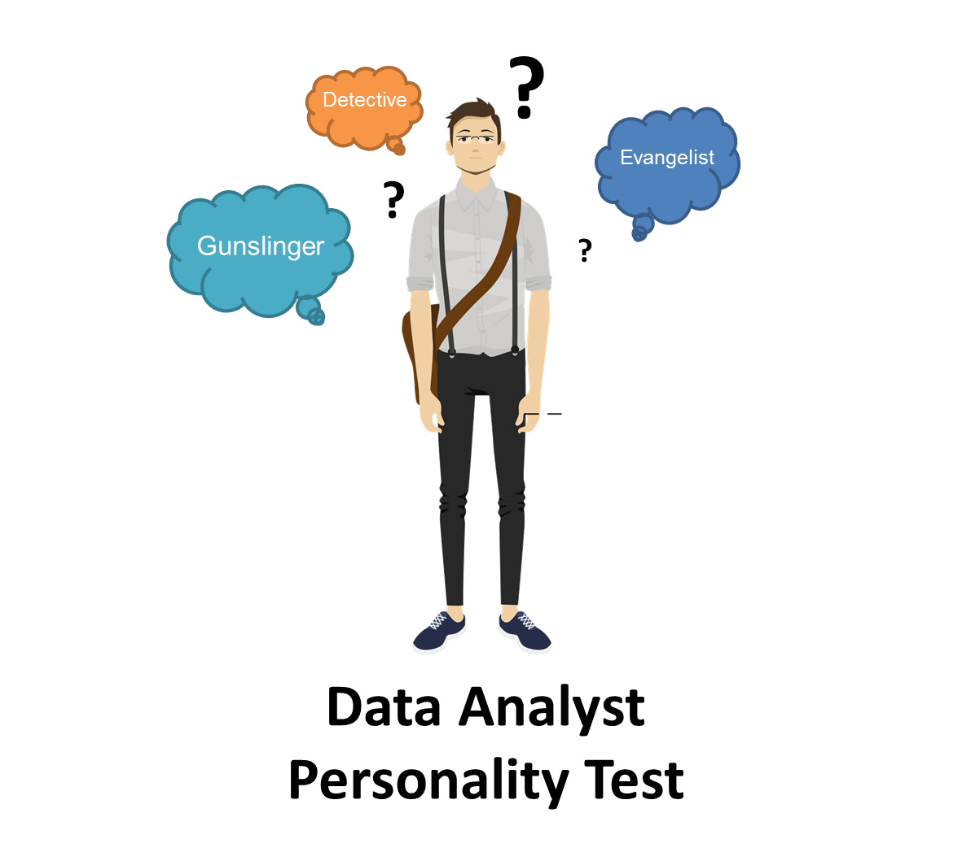
What is the profile of a patent analyst?
Patent search skills
Search and analysis tools
Synthesis skills
Attention to detail
Understanding of technical subject matter
Communication skills
Knowledge of IP system/IP Rights
Understanding of business needs/needs assessment
Translation of complex data into meaningful visualizations
Awareness raising about what analytics can provide
Source http://www.toadworld.com/

Slide 4
Stages of preparation of a patent landscape report

Slide 5







Different scenarios in the preparation of a Patent Landscape Report (PLR)
PLR prepared in-house or contracted out? (internal or external clients?)
Purpose of the report (business intelligence / competitor analysis or to serve public interest?)
Decision involved
Profile of client/team involved
Professor
Manager
Market Analyst
Patent Analyst

Slide 6
Stages in preparation of a WIPO PLR
Cooperation partner
Identifying the topic
Terms of Reference
Procurement
Preparation of the Report
Dissemination
Evaluation

Slide 7
What the cooperation partners are looking for
Factual evidence to facilitate policy discussions and various decisions (R&D prioritization, technology transfer etc)
IP Perspective of a technical/policy issue
Awareness on IP relevance and added value information deriving from patent data

Slide 8
WIPO cooperation partners
WIPO
WHO
AATF
Medicines Patent Pool
IRENA
FAO
GIWEH
UNEP/
Basel Convention
DNDi
CERN
MyIPO and MPOB
OMPIC and MASCIR

Slide 9
The lifecycle of a PLR
Delivering
Planning
Evaluating
Sharing

Slide 10
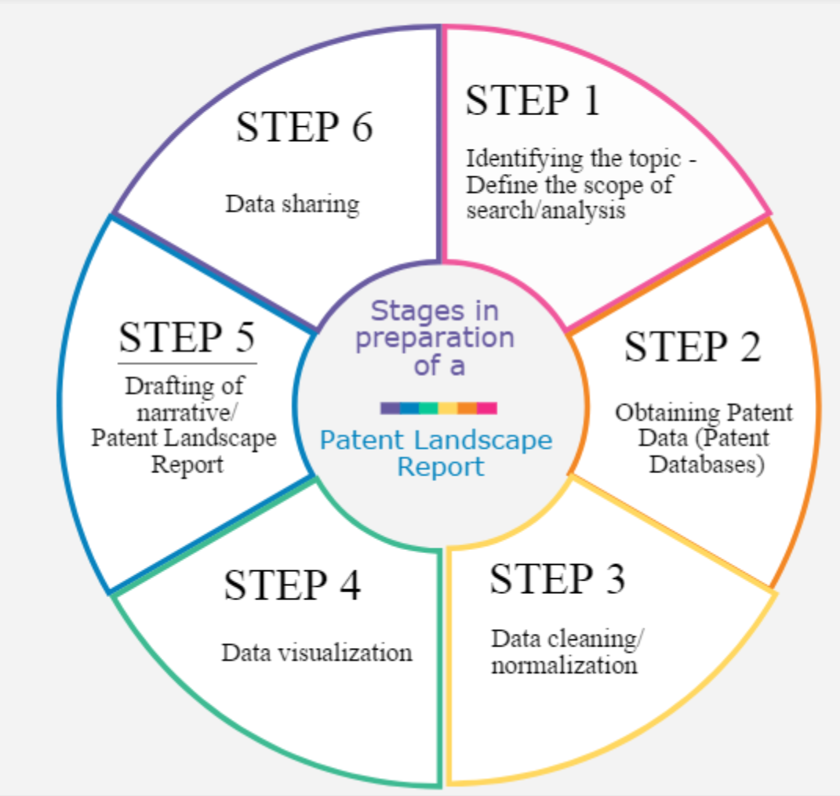
Stages in preparation of a PLR (tasks)

Slide 11
It all starts with…Planning
“A goal without a plan is just a wish.” Antoine de Saint-Exupéry“

Slide 12
Planning/Needs assessment
Understanding client’s business need, decision in question, relevant information
Brainstorming, discussion allowing for the client to better define his needs
Explaining options and limitations of patent landscaping
Timelines and feasibility
Sufficient background information
Ideally: interdisciplinary discussions (joint meetings of management, lawyers, R&D, business analysts, intelligence and patent information team)
Defining the scope of the report, the type of analysis that is useful and appropriate – reiterative process: need for intermediate discussions, redefinition of scope etc.

Slide 13
Challenges in the planning phase
Too abstract understanding of what a PLR is
Difficulties in needs assessment – often socratic method used
Lack of clarity about which type of analysis that is needed or exact scope of the search makes drafting the ToR very difficult
Lengthy process of dialogue, exchange of ToR drafts, refinements, changes
The client should be aware of the limitations of the patent information
Requests may just need a state of the art search or be too generic – need for awareness raising often about what landsacaping can offer and then cases when it is appropriate
Distinguishing general interest for the IP perspective from a specific need where patent analysis can feed in

Slide 14
Patent (and non-patent) search
Selection of databases, search methodology crucial for the quality of the data:
Required geographical and historical coverage
Languages and MT tools
Appropriate patent search strategy based on
scope of the report (precision&recall)
use of the report
subject matter in question
preliminary search

Slide 15
Data cleaning/normalization
The challenge of messy data – varies based on system where it is exported from and format
Name variations and misspellings
Cleaning of office of second file data
Numbers normalization
Need of name (applicants/inventors) normalization and grouping (by affiliation, M&A information etc)
Definition of needs and choice of tools
If the dataset comes from different sources, follow the same approach throughout the table/data
Based on system/tool used: manual or semi-automatic

Slide 16
Analysis and visualization of the clean data
Tools, visualization and analysis types to be chosen
Which data should be analyzed?
Dimensions to be reflected and correlated on a visualization (2, 3 or more) - correlation ≠ causation (!)
Clustering of technology areas, components, applications, applicant/inventor profile, geographical areas
Expression of results over time, geographies
Combination of patent with non-patent data
Consultation with the client throughout this and the writing phase essential to confirm that it serves their needs – preliminary results and analysis can trigger need for refinement of search or additional analysis

Slide 17
Preparation of the report and Communication of the results
Report style, language, length etc. should be adapted to the target audience
Big challenge: address the results to multiple profiles (lawyers, managers, scientists). A dedicated area of the report serving each and every one’s need most appropriate
The report should be easy to read, the messages and results clear and the visualizations intuitive and meaningful
An accompanying Infographic, a story-telling approach (e.g. Tableau), a dashboard may be more appropriate based on specific objective of the report
The report should be time-saving for the client and useful

Slide 18
How about the workflow? Patent Analytics Workflow
Examples
Scoping Search
Databases
Scientific Literature
Patent Data
drones or drones
Explore
Discuss
Test
drones or drones or unmanned aerial vehicle or autonomous aerial vehicle NOT bee or bees or mapis
Exploratory Data Visualization to help refine search
Define Search
save the raw dataset as raw and do not touch again unless needed (e.g. as a zip file). Document the steps taken to create the dataset and save with the raw file (e.g as a .txt file)
New Dataset
Save Raw Dataset as Raw
Clean main fields and then split joined (concatenated) fields and clean
Clean
Core Dataset
Split & Clean Applicants
Split & Clean Inventors
Split IPC
Split & Clean Other Fields
Visualise & Report
Tools such as Tableau, gephi and others such as using R packages, Python or Javascript libraries (D3.js)

Slide 19
Evaluation of the report
Evaluation: feedback from the client and lessons learned essential for improvement
Important also to measure the impact of the report in the decision-making mechanism
Sometimes the increase in requests is a good indicator of qualitative results and satisfied clients
Interviews, surveys or informal feedback can be used, based on the type of the evaluation, type and number of clients involved

Slide 20
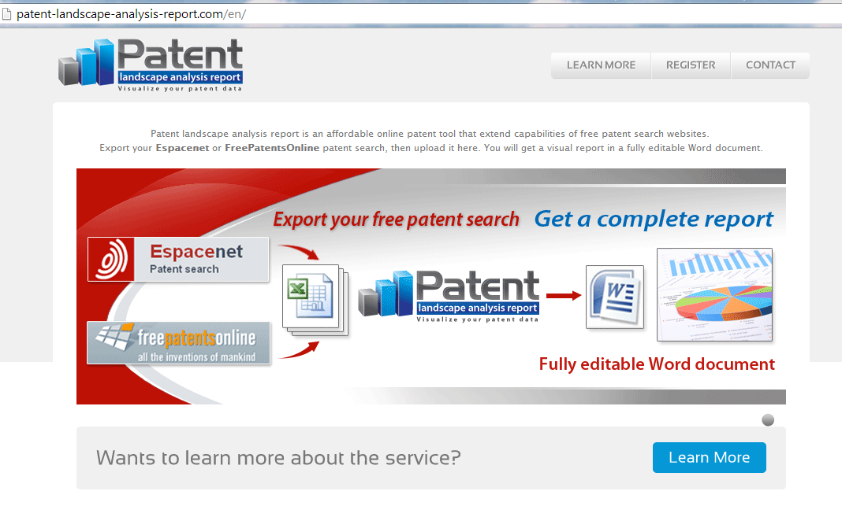
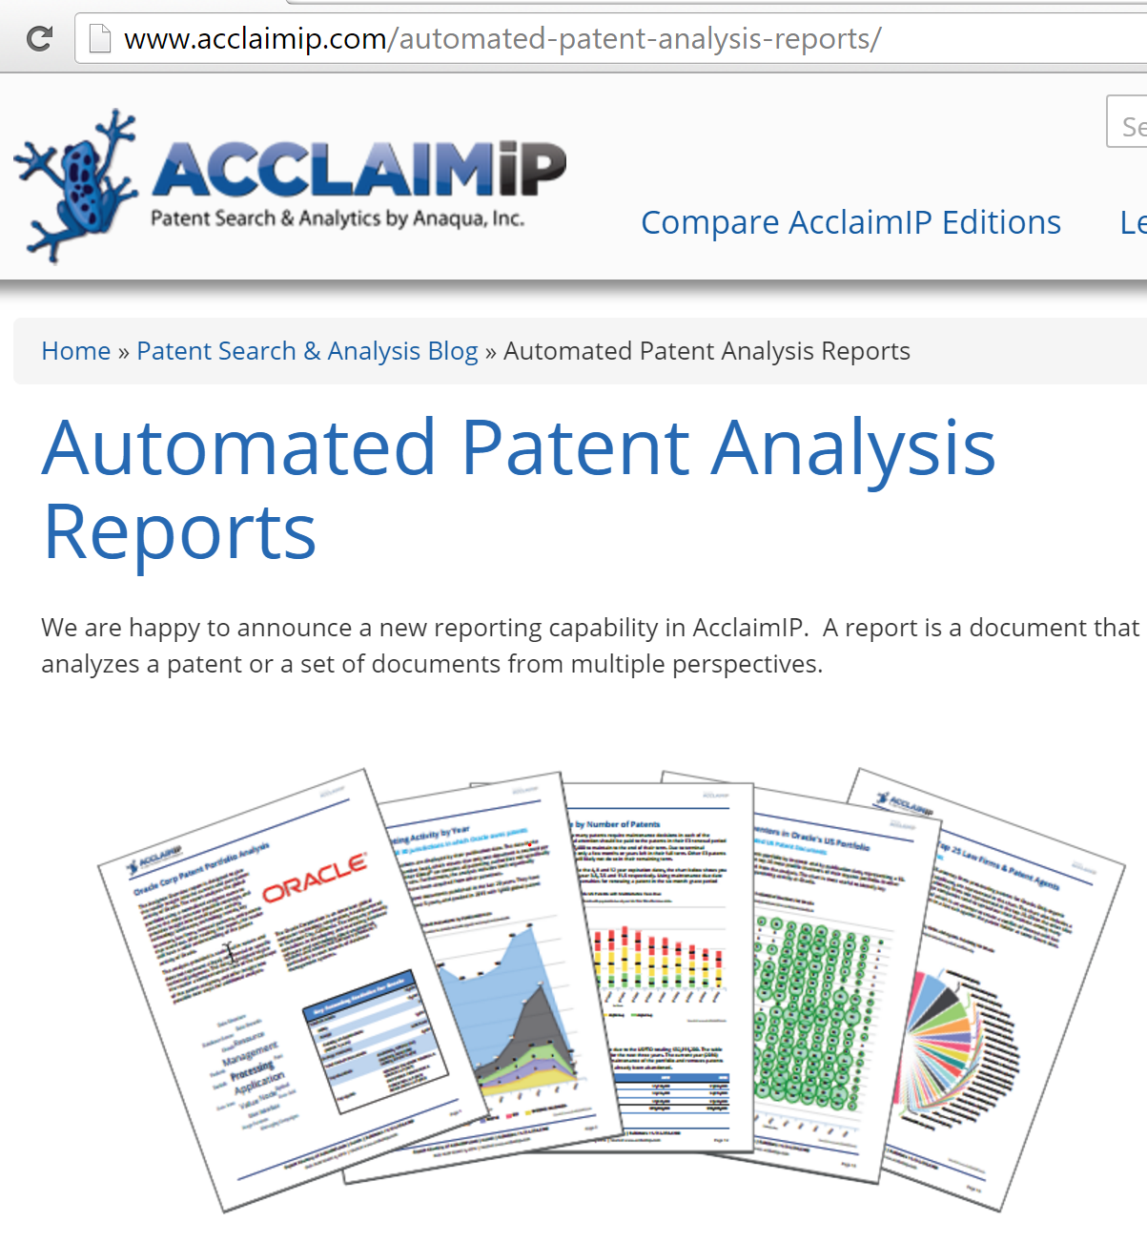
Tools for PLR Preparation
Efforts to create online semi-automated tools for the preparation of (semi-) automated PLR, e.g.

Slide 21
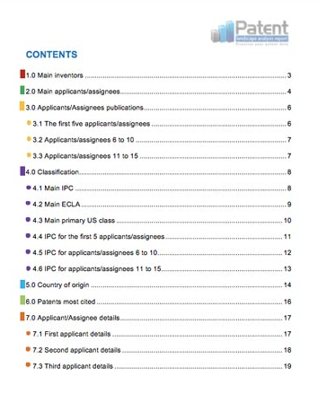
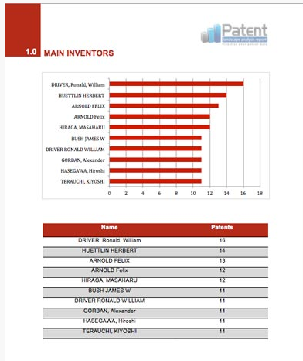
Tools for PLR preparation (2)

Slide 22

Tasks associated with Patent Analytics and Related Tools
Tasks and Tool types
Notes
General Tools
Search tools
Cleaning
Text/data mining
Data Visualization
Geographic Mapping
Network visualizations
Infographics
One tool suits all?
Some tools address multiple tasks
Each tool based on different language/approach
Each user should follow the «trial and error» approach

Slide 23
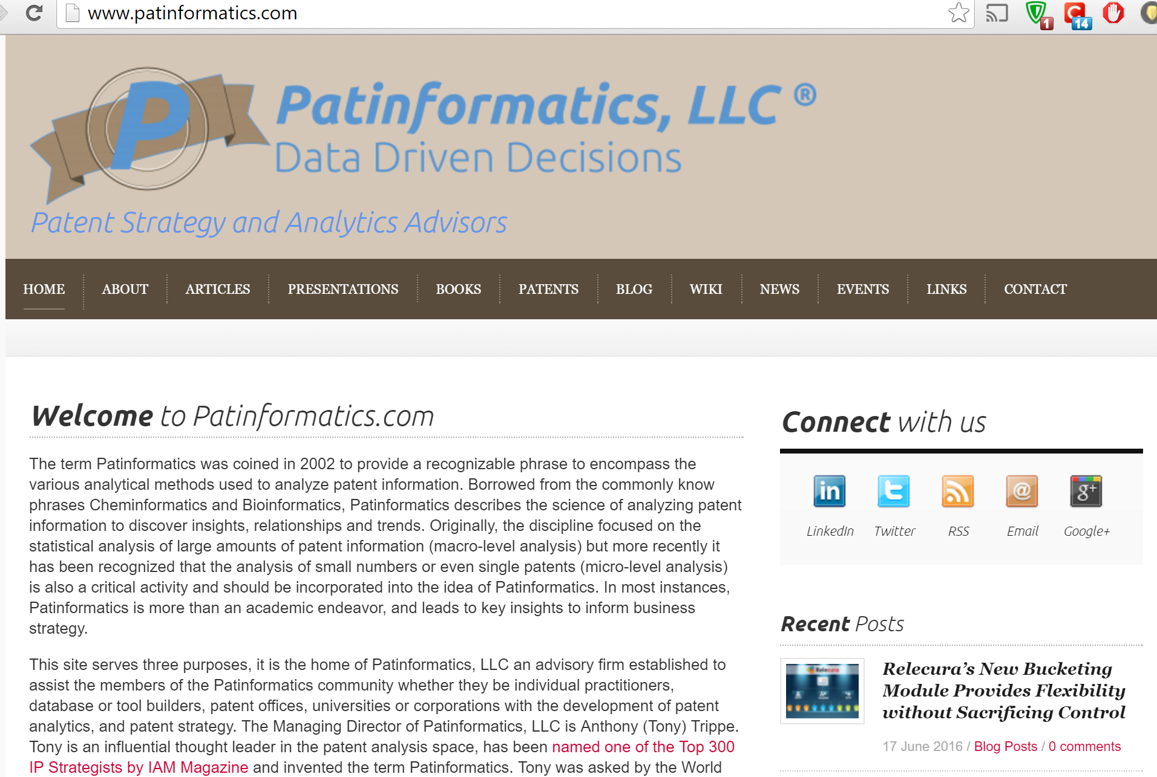
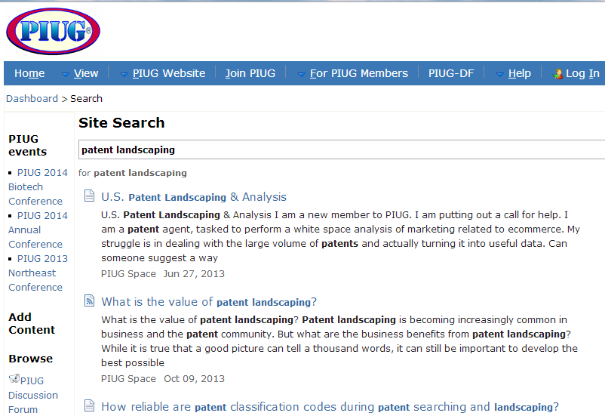
Blogs/Wiki/Online Fora on Patent Landscaping
www.patinformatics.com
http://wiki.piug.org

Slide 24
What type of tools are used in patent analytics?
To help in various stages and tasks involved in patent analytics:
(Searching)
Obtaining
Cleaning/Normalizing
Grouping/Clustering Data
Analyzing
Visualizing
Sharing

Slide 25





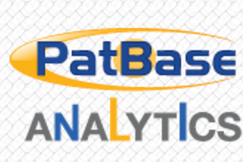








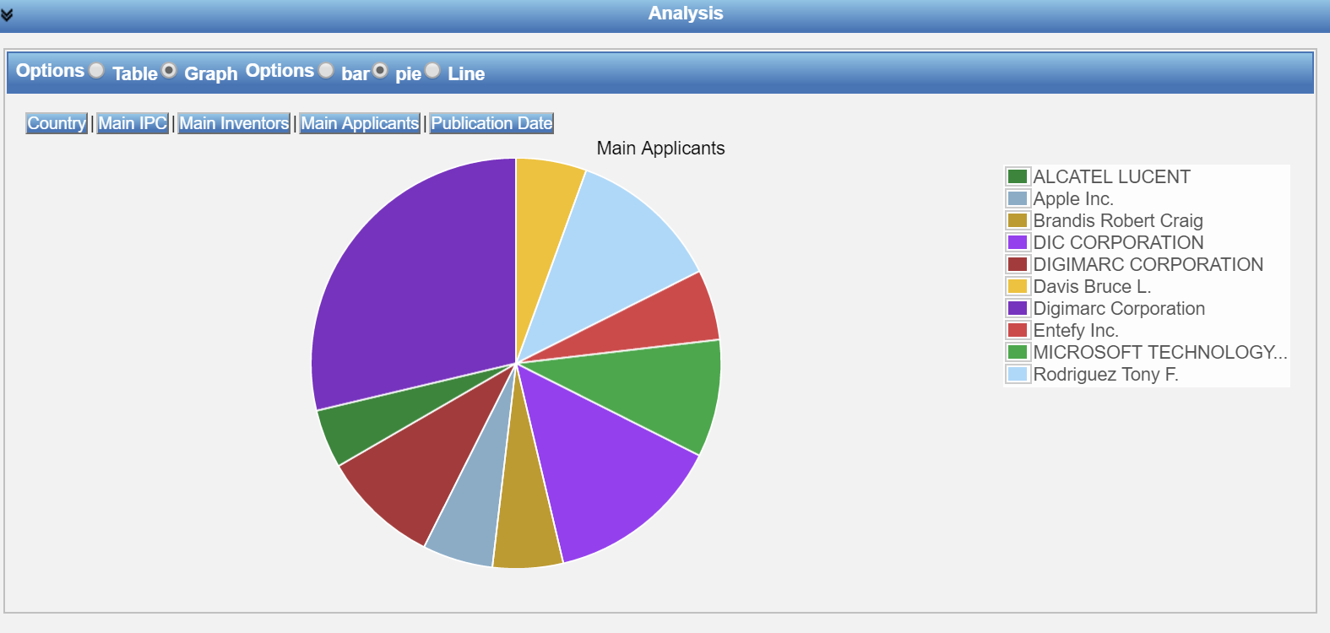

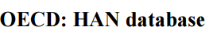

Tools used in Patent Analytics
Commercial:
Embedded in patent databases
Complementary to patent search tools and compatible
Typically dedicated to patent data, with some exceptions
Free of charge:
Some possibilities
Open Source Tools: recent trend

Slide 26
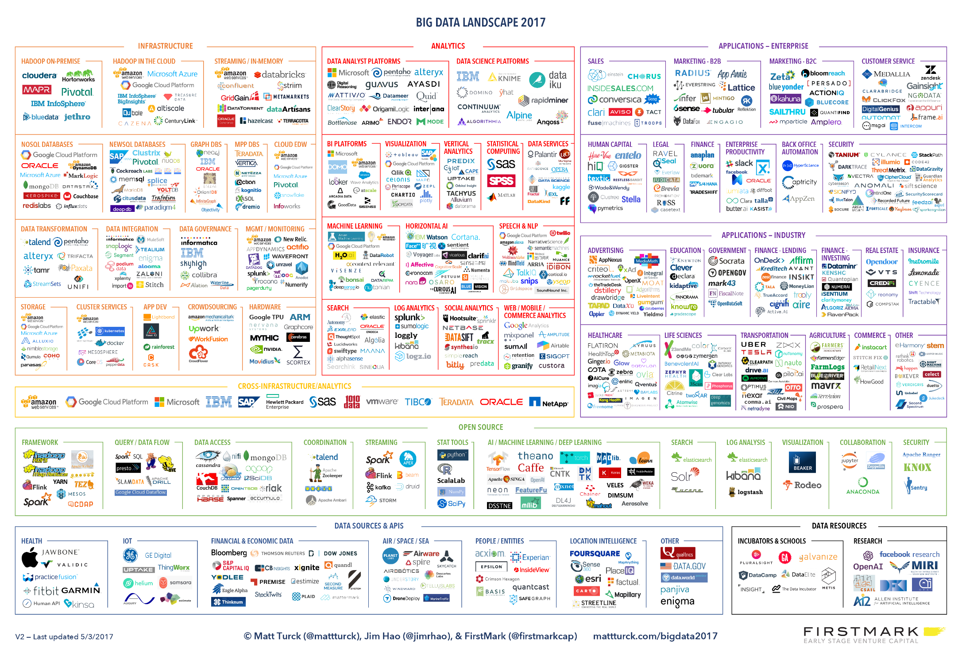
(…some of the) tools facilitating data analysis

Slide 27
Which tools are used in patent analytics?

Slide 28
WIPO Survey on the use of open source and free tools for patent analytics
Survey addressed to the community of patent information users on the tools they are using for patent analysis
13 questions in SurveyMonkey
Shared through PIUG Wiki, the German and the Italian Patent Information User Groups, WIPO Twitter and PLR website, Linkedin Patent Landscape Group.
Received 131 answers (81 answered all questions)

Slide 29
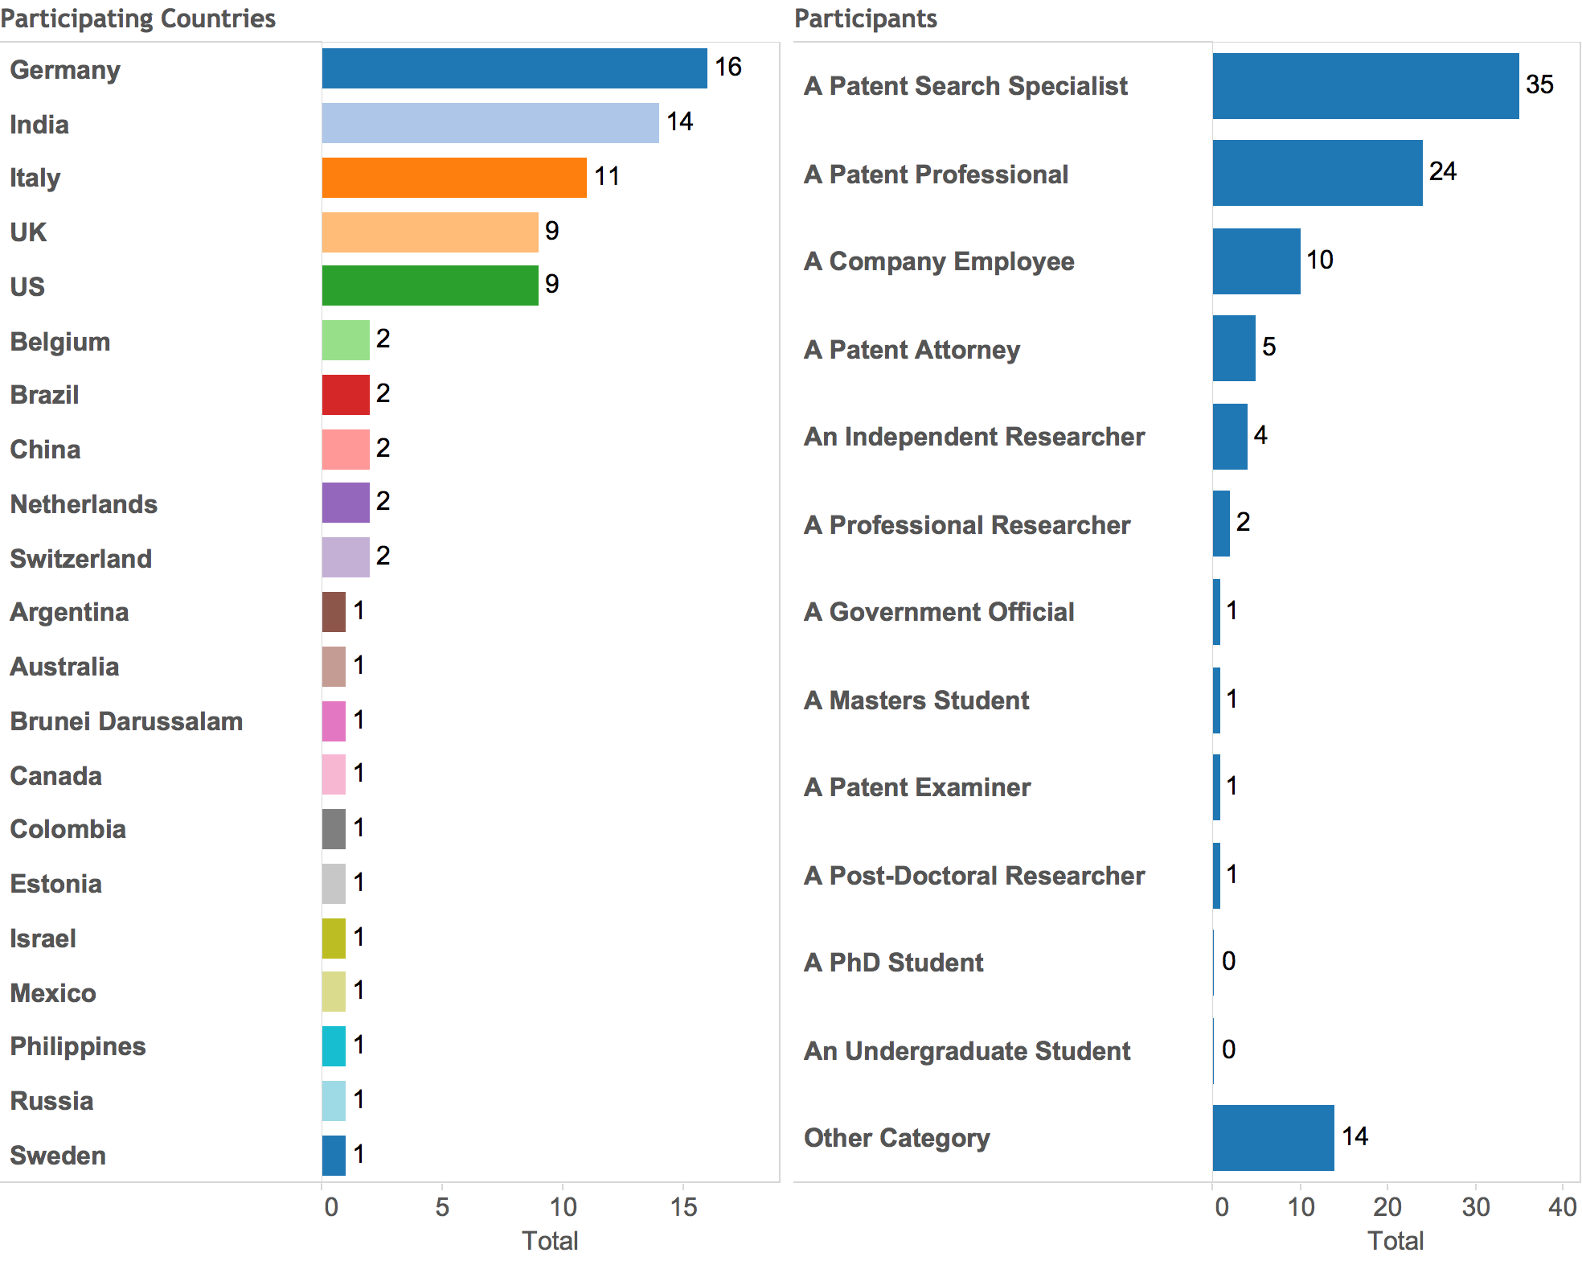
Survey results: participants profile
131 answers from 21 countries, mainly patent search professionals

Slide 30
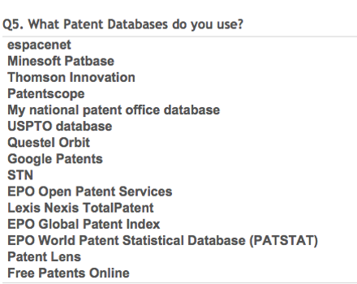
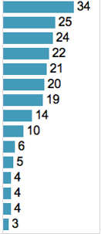
Survey results: Databases used for obtaining data for analytics
Mixture of free and commercial databases
Free databases: espacenet, followed by PATENTSCOPE
Commercial: Patbase, Thomson Innovation, Questel Orbit

Slide 31
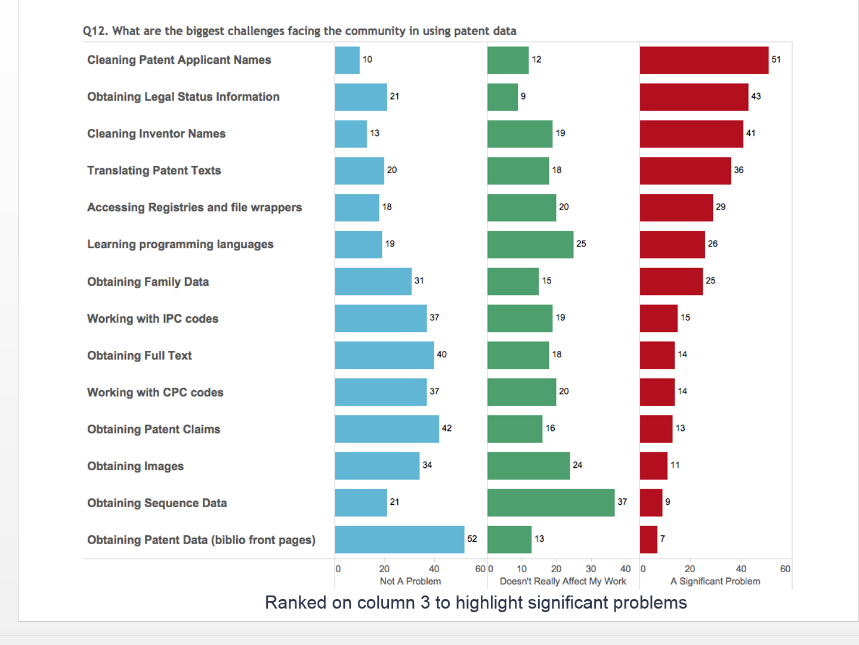
Greatest challenges in patent analytics identified by the survey participants

Slide 32














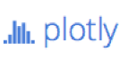
The open source tools era

Slide 33
Typical use of open source tools
Typical user profile:
Researchers
Data scientists
IT
Business analysts
Data typically analyzed through open source tools:
Unstructured data, structured non-patent data
Patent data: not a typical field where open source tools are being used

Slide 34

Pros and cons of open source tools
Advantages
Disadvantages
Free of charge
A lot of them customizable to specific needs
Give flexibility to experiment and choose the tool or combination of tools that is more adapted to the user´s needs
Support and troubleshooting by programmers and other users in various fora
Not as intuitive or user-friendly as commercial tools
Require some programming skills, time and practice
Several bugs/problems
No commercial support

Slide 35
Recent trend of using open source tools and data analytics principles for patent data
Increasing number of private sector corporations using a combination of commercial and open source tools:
Commercial tools
Open-source tools
Increased data availability
Additional information (litigation, market /business information, legal status information…)
Algorithms to create preset of visualizations (ease of use yet often « black boxes »)
Increased flexibility in defining cleaning/normalization/clustering parameters, and controlling/understanding how the results were produced
Building additional elements based on specific needs of the company

Slide 36

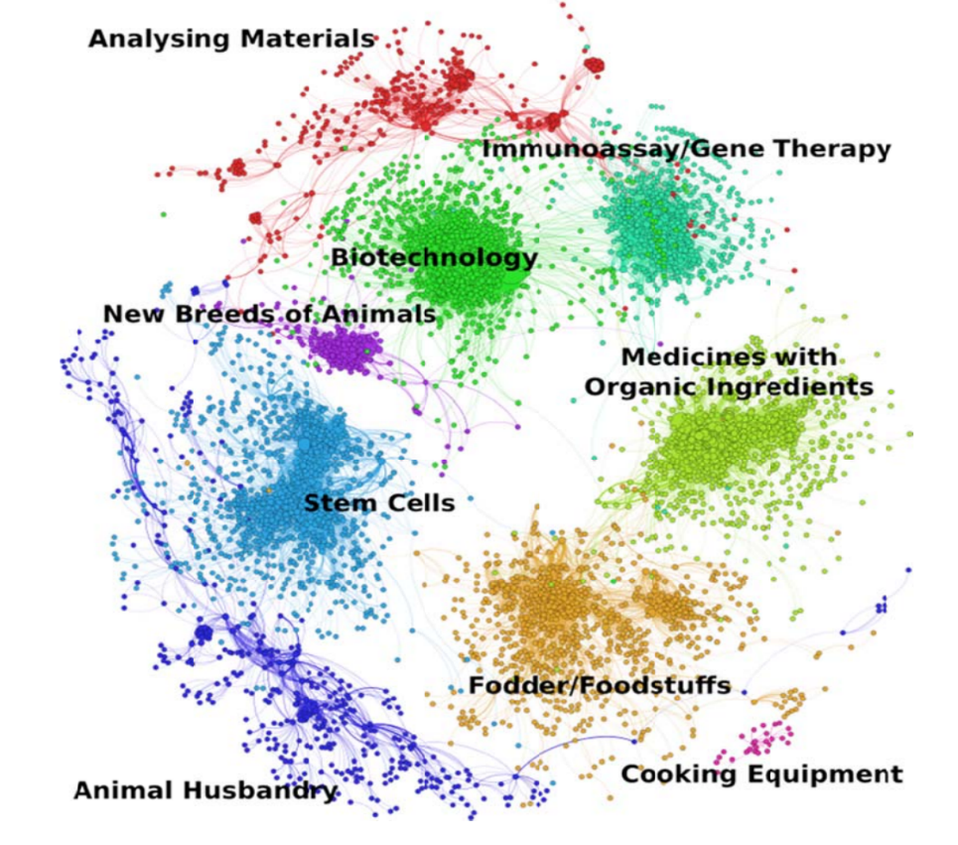
First thoughts on using open source tools for patent analytics
WIPO PLRs 2010-2014: exploring various commercial analysis and visualization tools
2014: WIPO animal genetic resources PLR used for the first time Gephi, an open-source tool.

Slide 37
The Manual on Open Source Tools for Patent Analytics
Project launched in May 2015, funded by FIT-JP
Key author of the Manual: Paul Oldham
Aimed at exploring:
various free and open source tools which could be used for various patent analysis tasks by users in developing countries
How to obtain data to use for patent analytics
How to clean/tidy, analyze, visualize and share patent data with the help of selected open source tools
Challenge: programming skills required
The Manual includes step-by-step instructions on the use of selected open source/free tools

Slide 38
Challenges when working with open-source tools
Acquiring programming skills – sometimes steep learning curve
Selecting the open source tools to explore and cover in the Manual
Deal with constantly changing open source landscape

Slide 39

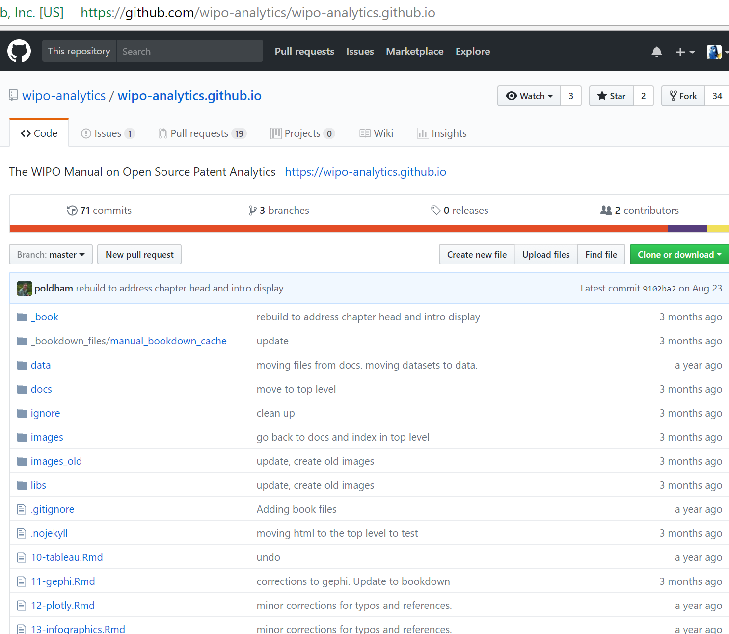
The project approach
The Project Development Site and its Repository – meet Github
https://github.com/wipo-analytics/wipo-analytics.github.io

Slide 40
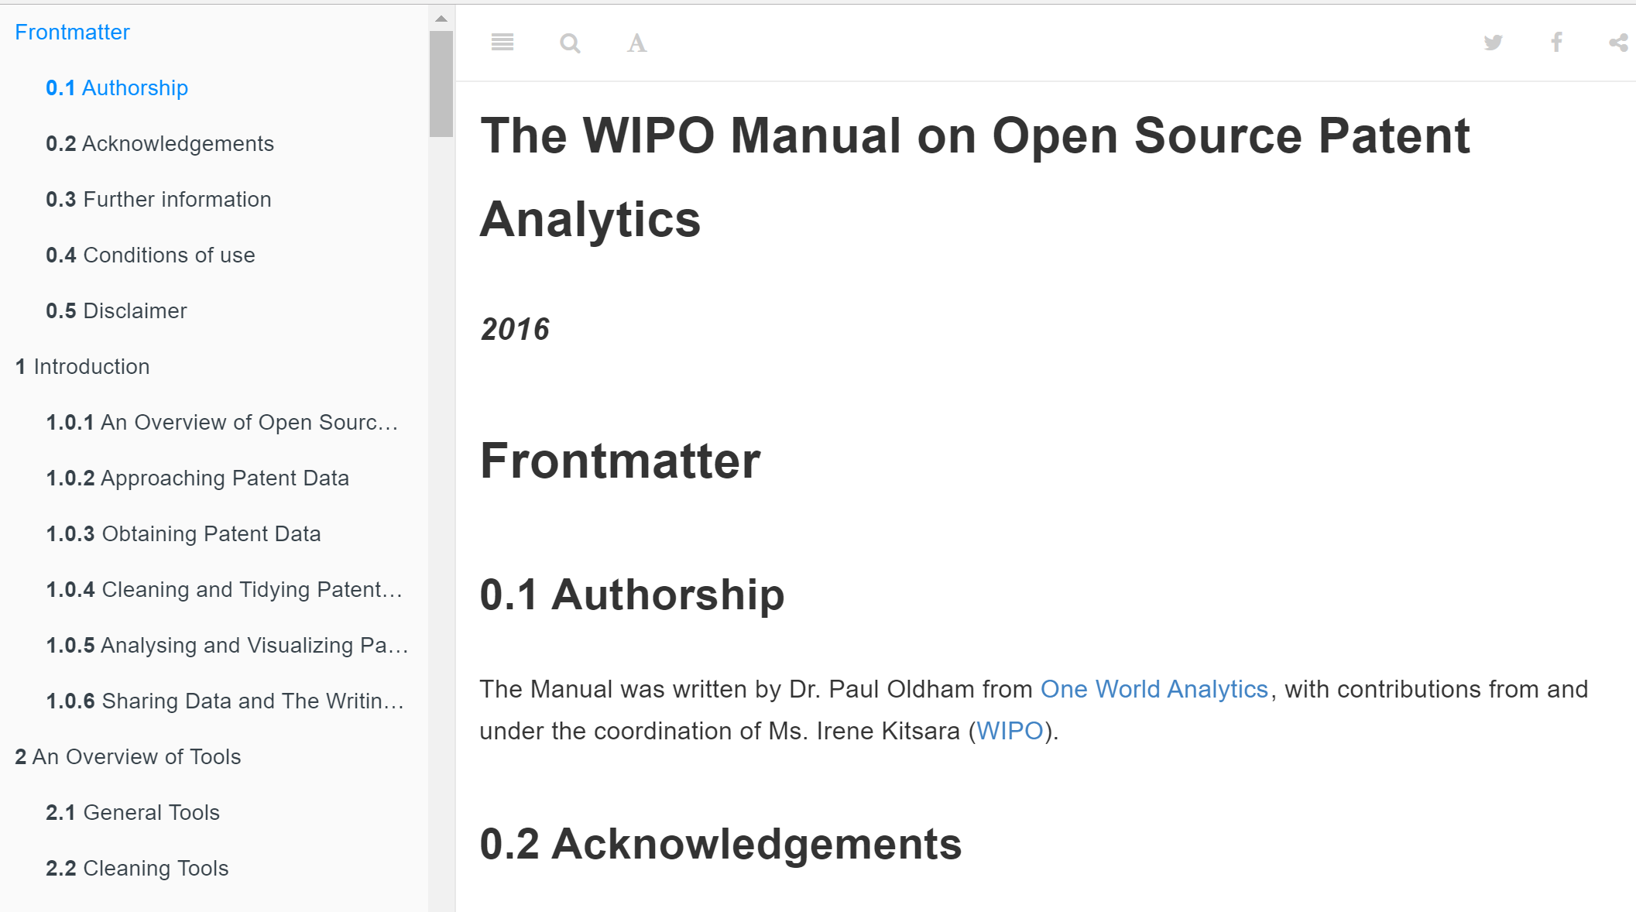
The Manual Repository with the Manual Chapters
The Manual was prepared in RMarkdown
https://wipo-analytics.github.io/

Slide 41
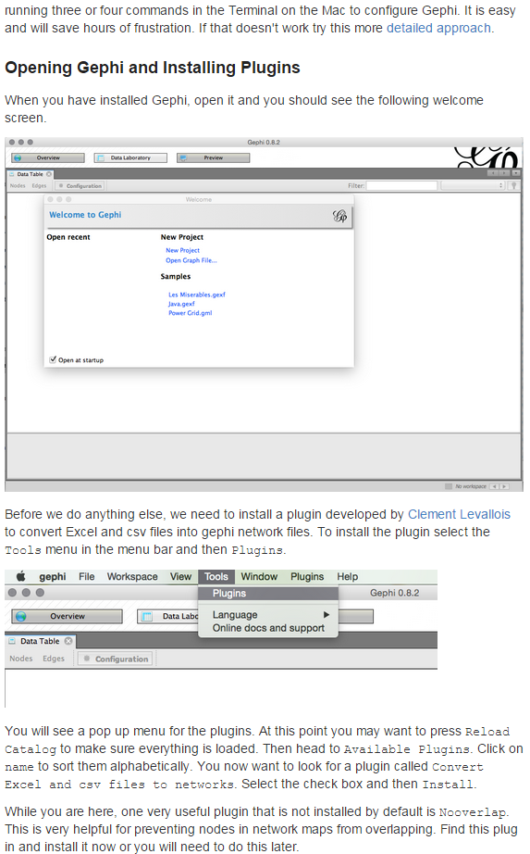
The Manual Chapters
Step-by-step instructions and guidance
Screenshots
Links to tutorials and further useful resources
Tips and tricks

Slide 42












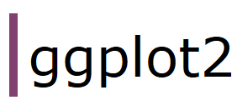


Which analytics tasks, databases and tools does the Manual cover?
Obtaining Data
Cleaning Data
Visualizing Data
Sharing Data

Slide 43
Remember the tasks and the workflow involved in analytics
Irene.Kitsara@wipo.int

